Slide 1
LCLS-II High Q₀ Cavities: Lessons Learned
Dan Gonnella
For the LCLS-II Project

Slide 2
Outline
Overview of LCLS-II Cavity Requirements
Initial LCLS-II Results
Lesson Learned: Flux Expulsion
Lesson Learned: Nitrogen-Doping, R_{BCS}
Vendor B Production Results
Lesson Learned: Vendor Oversight
Conclusions and Outlook

Slide 3
Outline
Overview of LCLS-II Cavity Requirements
Initial LCLS-II Results
Lesson Learned: Flux Expulsion
Lesson Learned: Nitrogen-Doping, R_{BCS}
Vendor B Production Results
Lesson Learned: Vendor Oversight
Conclusions and Outlook

Slide 4
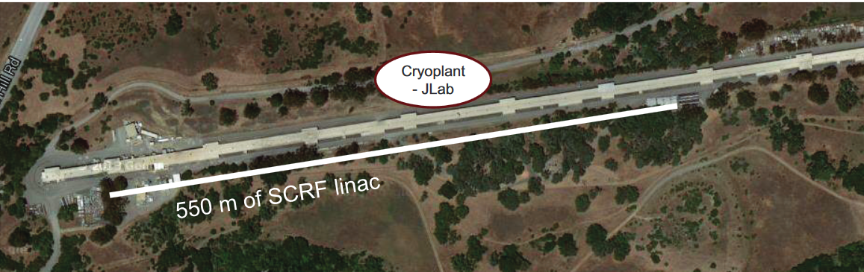
Introduction to LCLS-II
The SRF linac is closely based on the XFEL/ILC/TESLA Design
It consists of 35 cryomodules each with 8 cavities – total of 280 cavities
The 280 1.3 GHz 9-cell cavities have a very ambitious Q specification:
Additionally, cavities must reach 19 MV/m
2.7 x 10¹⁰ at 16 MV/m and 2 K
2.5 x 10¹⁰ at 16 MV/m and 2 K
Q specification lowered in VT due to addition of stainless steel blank on short side of cavity – adds ~0.8 nΩ of R_{res}

Slide 5
Cavity Preparation
In order to achieve the ambitious Q specification, all 9-cell cavities for LCLS-II are prepared with nitrogen-doping
Original recipe:
140 μm bulk EP
800ºC degas for 3 hours in vacuum
2 minutes at 800ºC in 20-30 mTorr of N₂
6 minutes at 800ºC in vacuum
5-7 μm light EP

Slide 6
Cavity Preparation
In order to achieve the ambitious Q specification, all 9-cell cavities for LCLS-II are prepared with nitrogen-doping
Original recipe:
140 μm bulk EP
800ºC degas for 3 hours in vacuum
2 minutes at 800ºC in 20-30 mTorr of N₂
6 minutes at 800ºC in vacuum
5-7 μm light EP

Slide 7
Cavity Preparation
In order to achieve the ambitious Q specification, all 9-cell cavities for LCLS-II are prepared with nitrogen-doping
Original recipe:
140 μm bulk EP
800ºC degas for 3 hours in vacuum
2 minutes at 800ºC in 20-30 mTorr of N₂
6 minutes at 800ºC in vacuum
5-7 μm light EP
Cavities are being produced by Research Instruments GmbH (RI) and Ettore Zanon S.p.a (EZ)
Niobium was procured from Tokyo Denkai and OTIC Ningxia

Slide 8
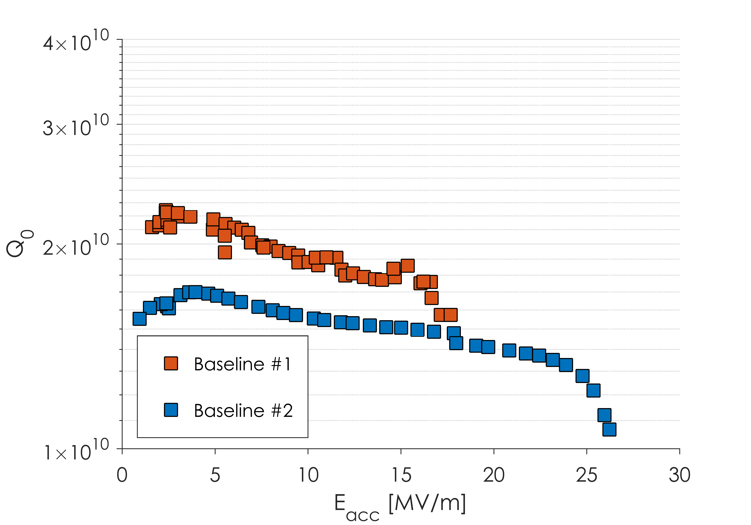
Nitrogen-Doping Introduction

Slide 9
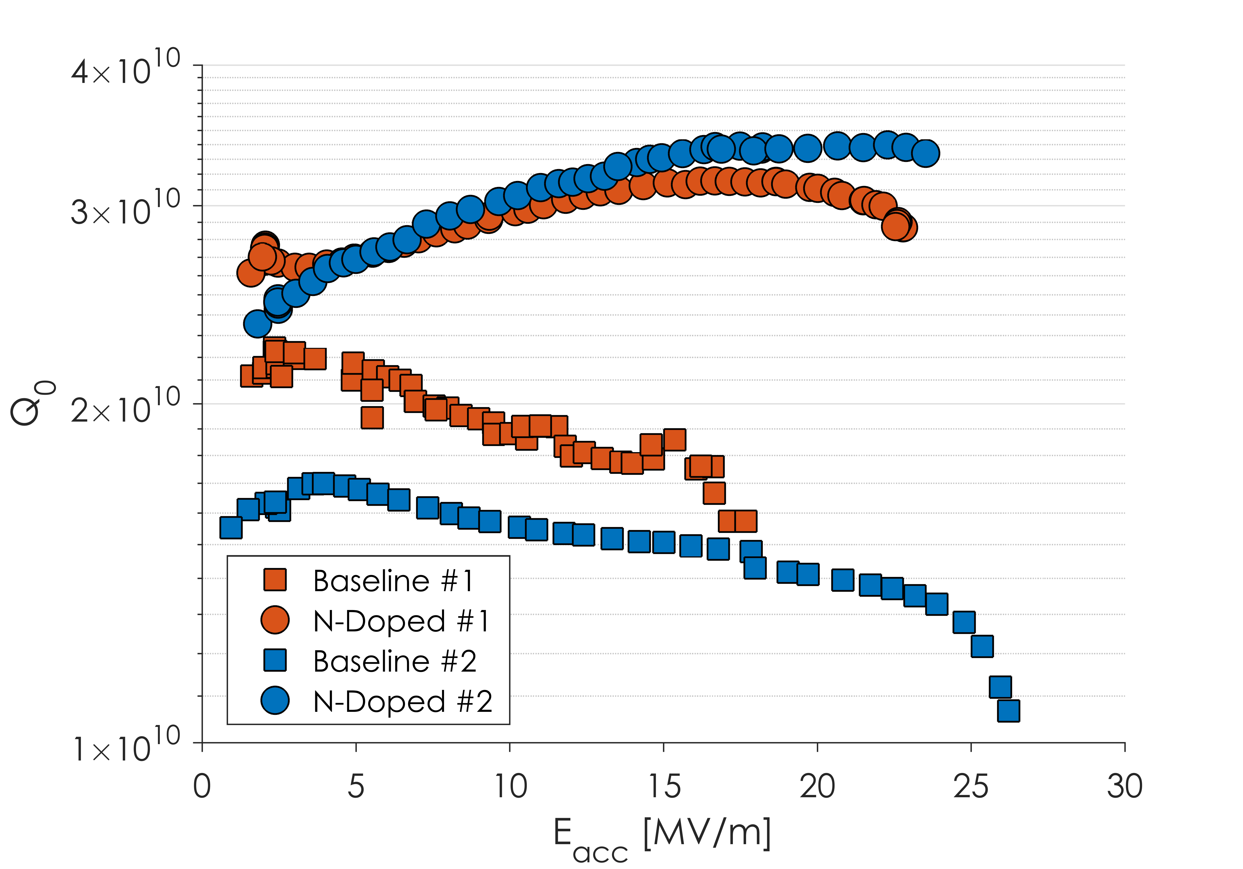
Nitrogen-Doping Introduction
Q is improved by 2 mechanisms:
Higher starting Q₀
Anti-Q slope
Both of these are a resulting of a changing R_{BCS}
Q₀’s of >3x10¹⁰ can consistently be produced

Slide 10
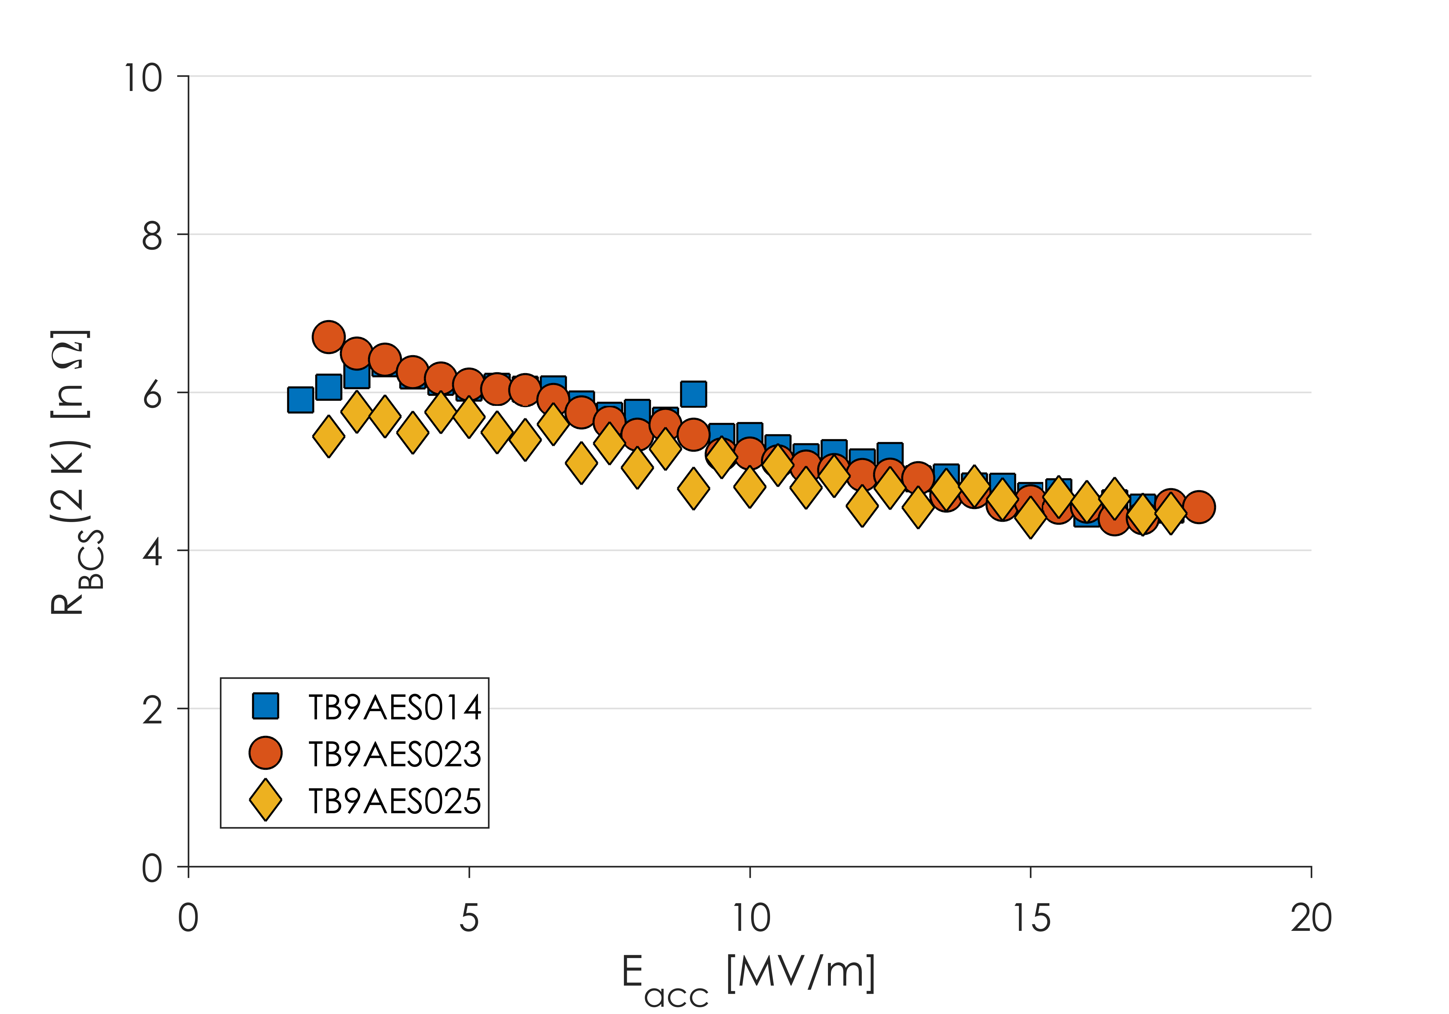
Anti-Q Slope
Anti-Q Slope caused by a decreasing R_{BCS}
Vendor Qualification Cavities
Low R_{BCS} and anti-Q slope are characteristic of nitrogen-doped cavities

Slide 11
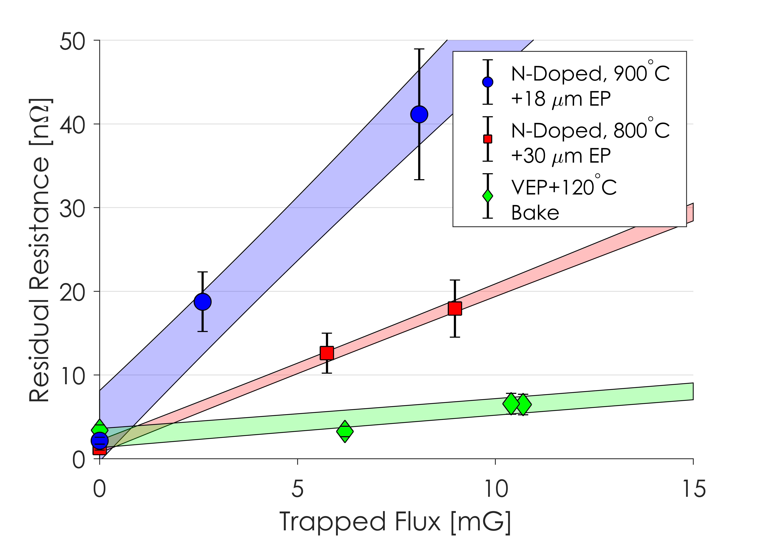
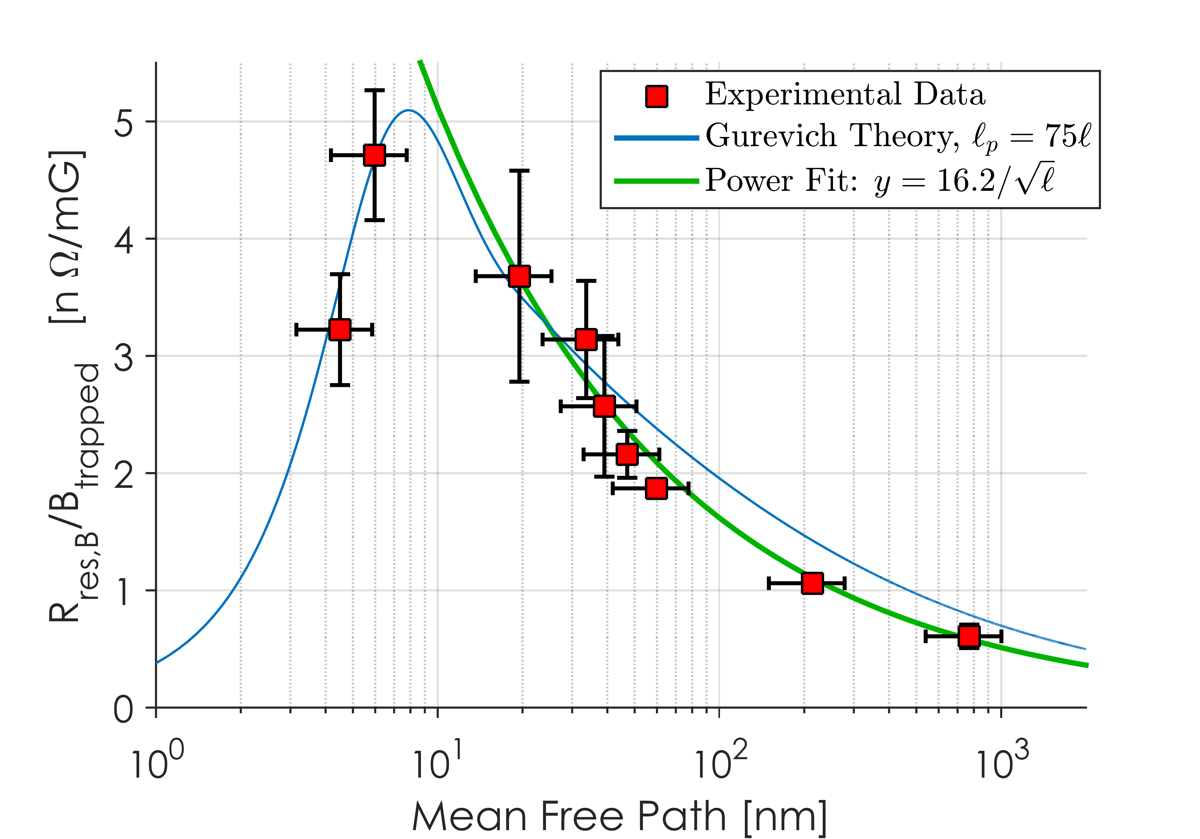
Drawbacks of N-Doping
Q₀ is significantly improved by the lowering of R_{BCS}
There is a tradeoff however with R_{res}
Nitrogen-doped cavities are more sensitive to losses from trapped magnetic flux
For the same amount of trapped flux, a N-doped cavity will have a higher R_{res} than an un-doped cavity
3.4x for the LCLS-II cavity recipe
This requires efficient flux expulsion or small ambient magnetic fields to maintain high Q₀
Presented at SRF 2015 and J. Appl. Phys. 119:073904

Slide 12
Outline
Overview of LCLS-II Cavity Requirements
Initial LCLS-II Results
Lesson Learned: Flux Expulsion
Lesson Learned: Nitrogen-Doping, R_{BCS}
Vendor B Production Results
Lesson Learned: Vendor Oversight
Conclusions and Outlook

Slide 13
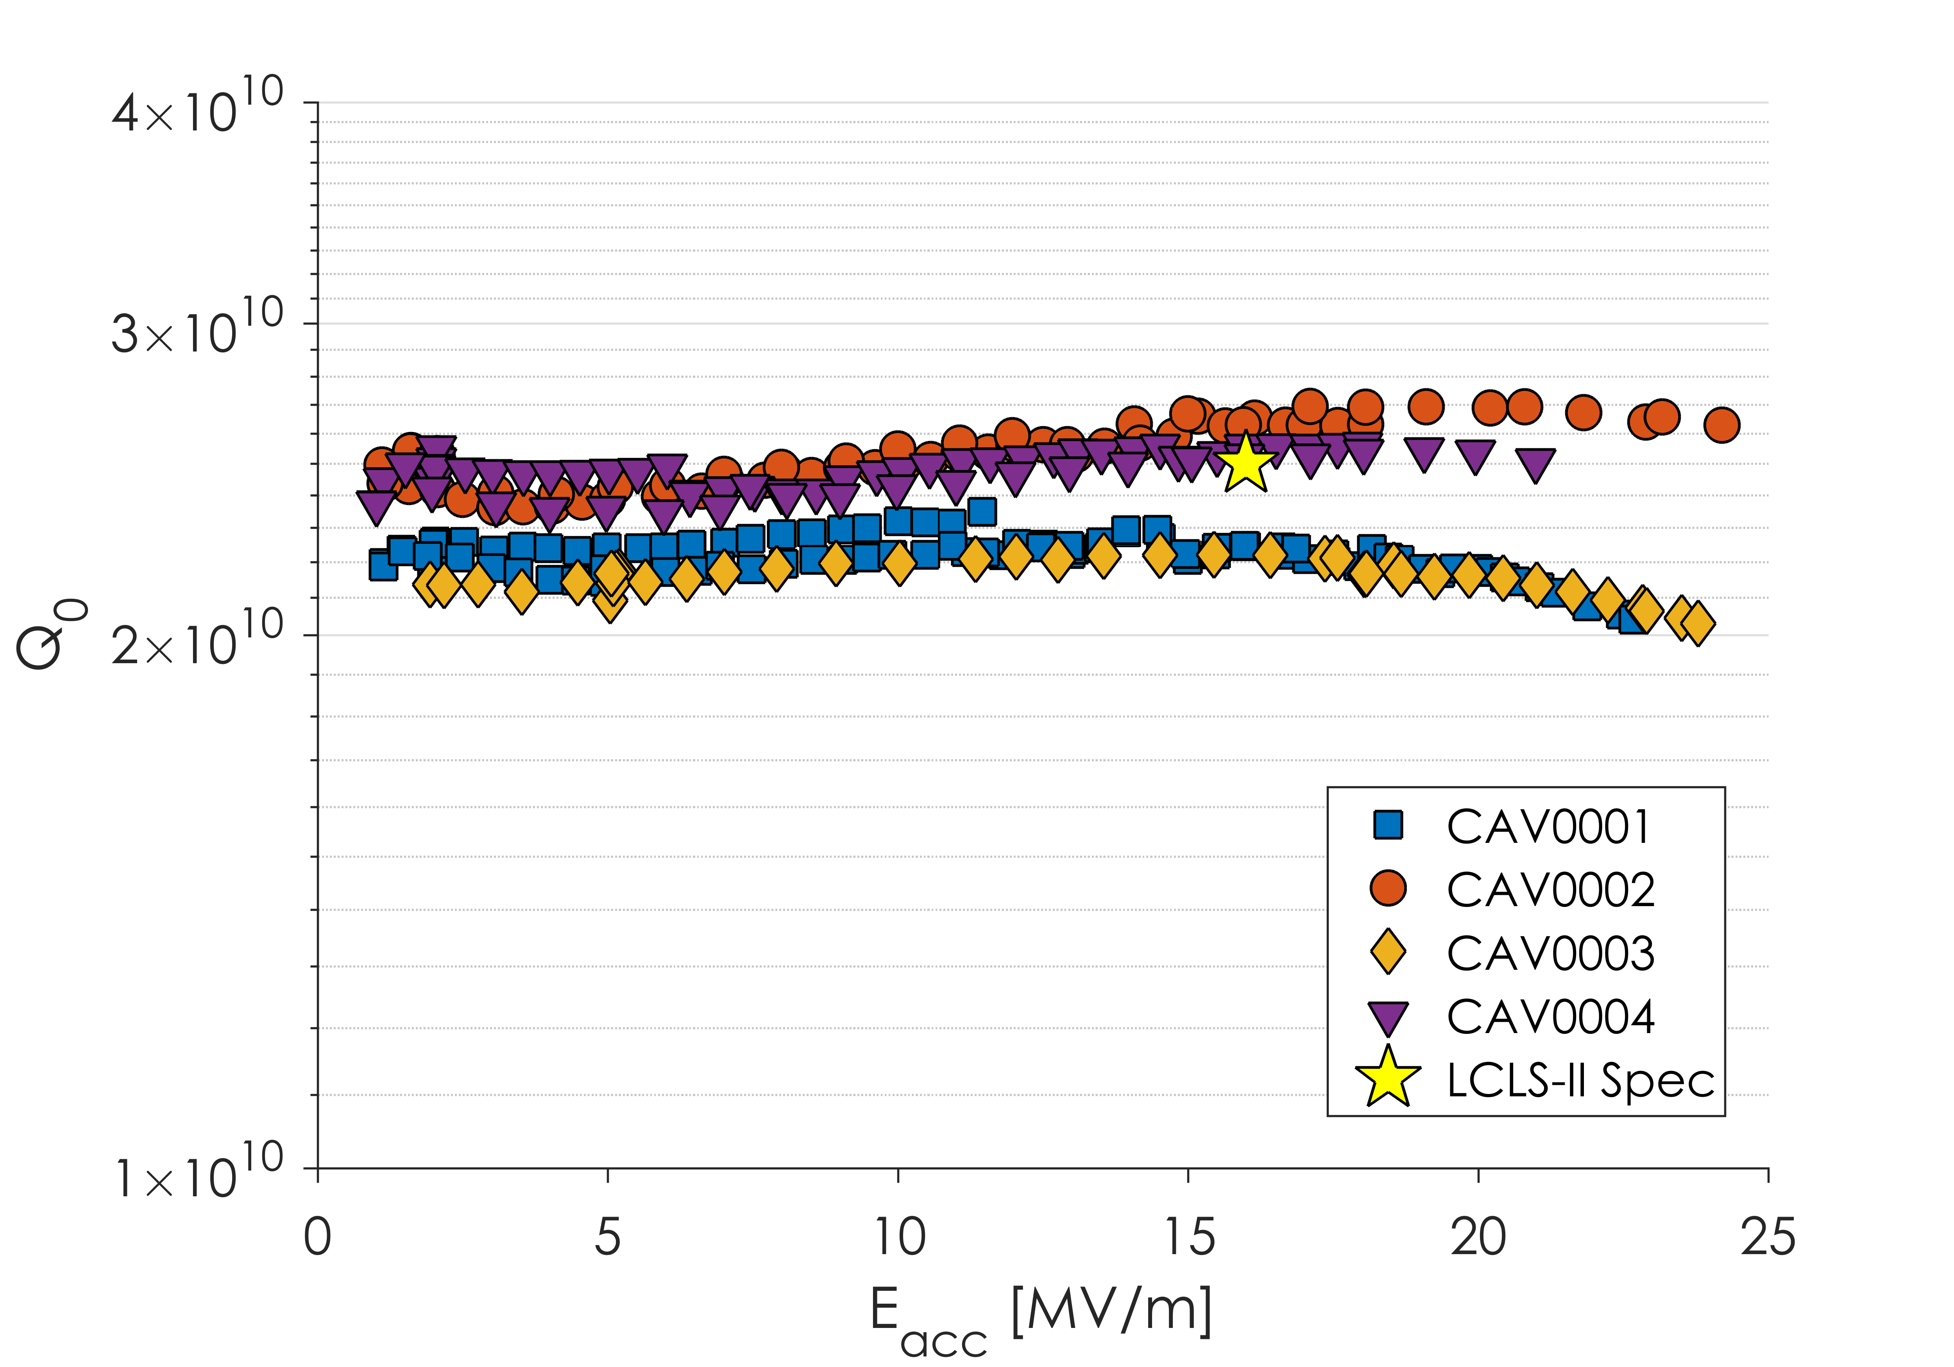
Q vs E for First Article Cavities
Some Great Cavities
Some Good Cavities
All these cavities tested in very low (0-1 mG) magnetic fields

Slide 14
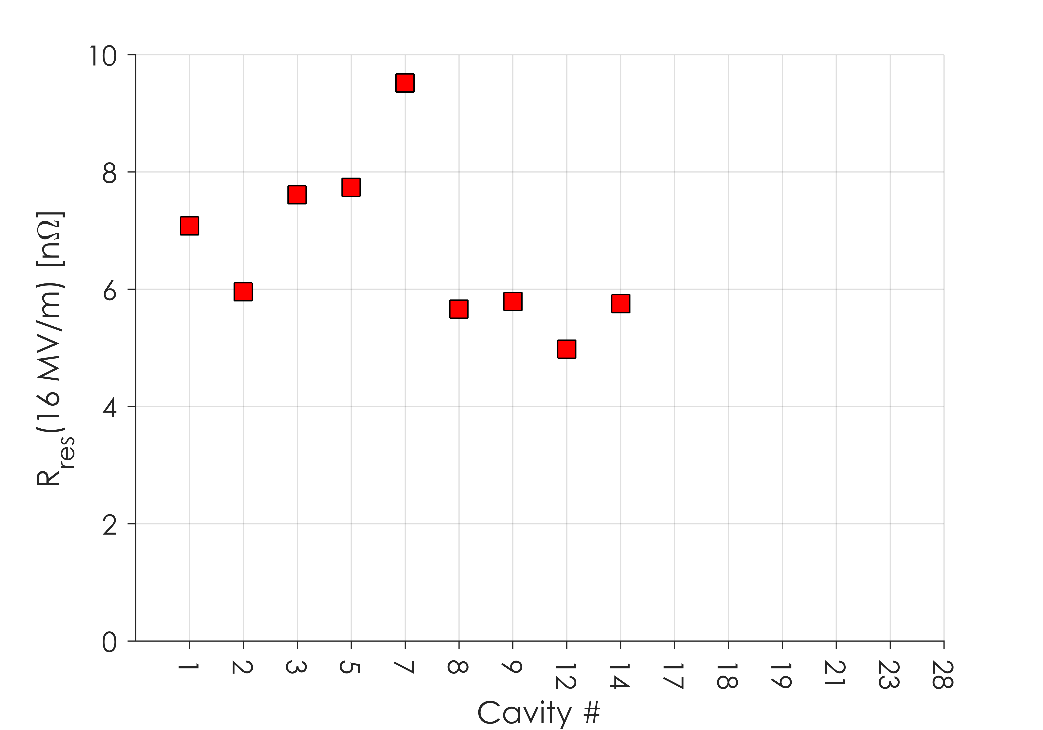
Residual Resistance in First Articles
R_{res} higher than in the prototyping phase
Expected 2-3 nΩ, found 5-9 nΩ
Spread is a result of differences in ambient magnetic fields

Slide 15
Outline
Overview of LCLS-II Cavity Requirements
Initial LCLS-II Results
Lesson Learned: Flux Expulsion
Lesson Learned: Nitrogen-Doping, R_{BCS}
Vendor B Production Results
Lesson Learned: Vendor Oversight
Conclusions and Outlook

Slide 16
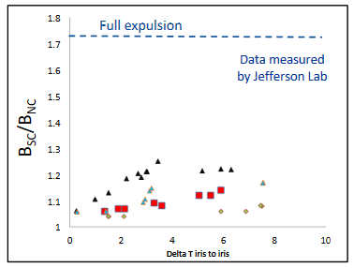
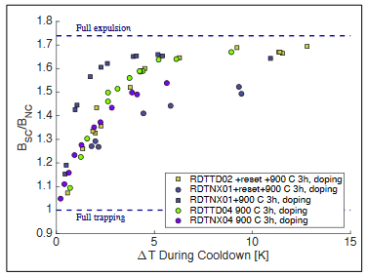
Flux Expulsion in Production Material
As received material for LCLS-II Production
After 900ºC Heat Treatment
With the 800ºC recipe, flux expulsion was much worse than on the prototype material
Raising the temperature to 900ºC significantly improved flux expulsion
Slide from S. Posen, TTC 2017

Slide 17
Issues with Original Recipe
Material from both vendors showed worse flux expulsion when treated at 800ºC in single-cell cavity tests than material used during the prototyping and R&D stage
All material meets specifications
This means that magnetic field specifications would need to be tighter in order to minimize the need for efficient flux expulsion
Cryomodule results thus far have shown ambient magnetic fields less than the LCLS-II CM Spec of 5 mG – further improvement on this would be difficult
140 μm bulk EP was insufficient to remove the damage layer, adding additional R_{res}
Worse flux expulsion is an independent phenomena from N-Doping – It impacts all cavity preparation methods

Slide 18
Cavity Preparation
In order to achieve the ambitious Q specification, all 9-cell cavities for LCLS-II are prepared with nitrogen-doping
Updated recipe:
200 μm bulk EP
900ºC degas for 3 hours in vacuum
2 minutes at 800ºC in 20-30 mTorr of N₂
6 minutes at 800ºC in vacuum
5-7 μm light EP

Slide 19
Residual Resistance in First Articles

Slide 20
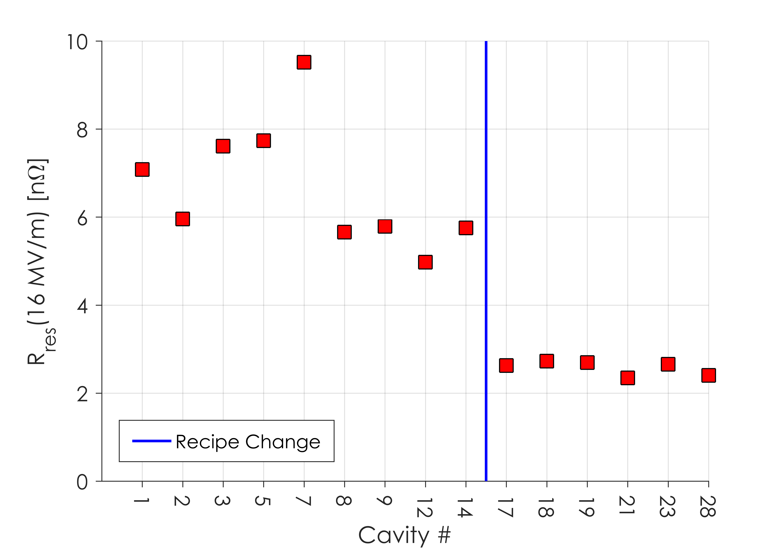
Residual Resistance After Recipe Change
Spread lower due to near 100% FE
After Increasing Bulk EP and Degas Temperature,
R_{res} is consistently ~2 nΩ

Slide 21
Q vs E for First Article Cavities

Slide 22
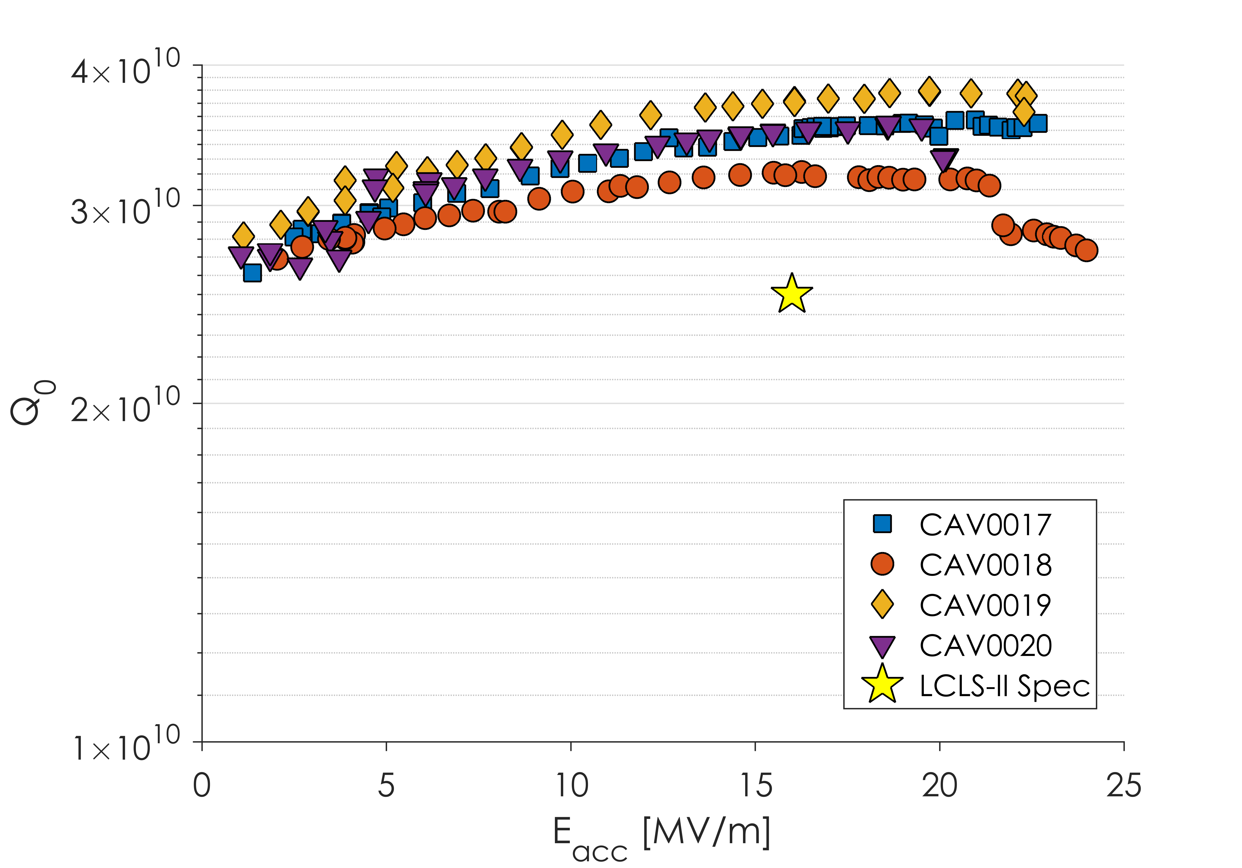
Q vs E for First Article Cavities
Cavities now consistently meet Q₀ specification

Slide 23
Lesson 1: Efficient flux expulsion is necessary to maintain High Q₀ in N-Doped Cavities
Cavities now consistently meet Q₀ specification

Slide 24
Outline
Overview of LCLS-II Cavity Requirements
Initial LCLS-II Results
Lesson Learned: Flux Expulsion
Lesson Learned: Nitrogen-Doping, R_{BCS}
Vendor B Production Results
Lesson Learned: Vendor Oversight
Conclusions and Outlook

Slide 25
Reminder: Anti-Q Slope
Vendor Qualification Cavities

Slide 26
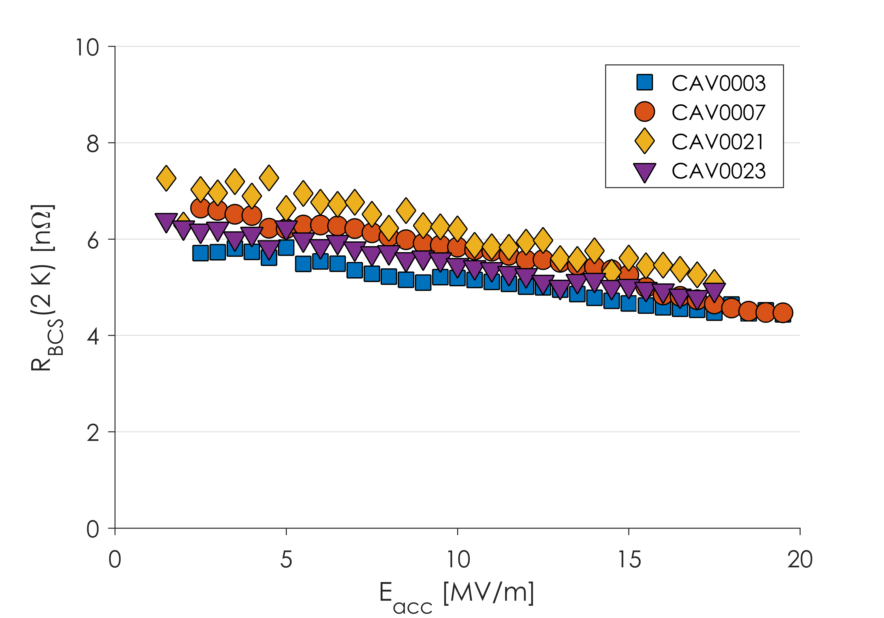
R_{BCS} in Production Cavities
Strong Anti-Q Slope
Decreasing R_{BCS} from ~7 to ~4 nΩ
Production cavities show similar anti-Q slope to R&D cavities

Slide 27
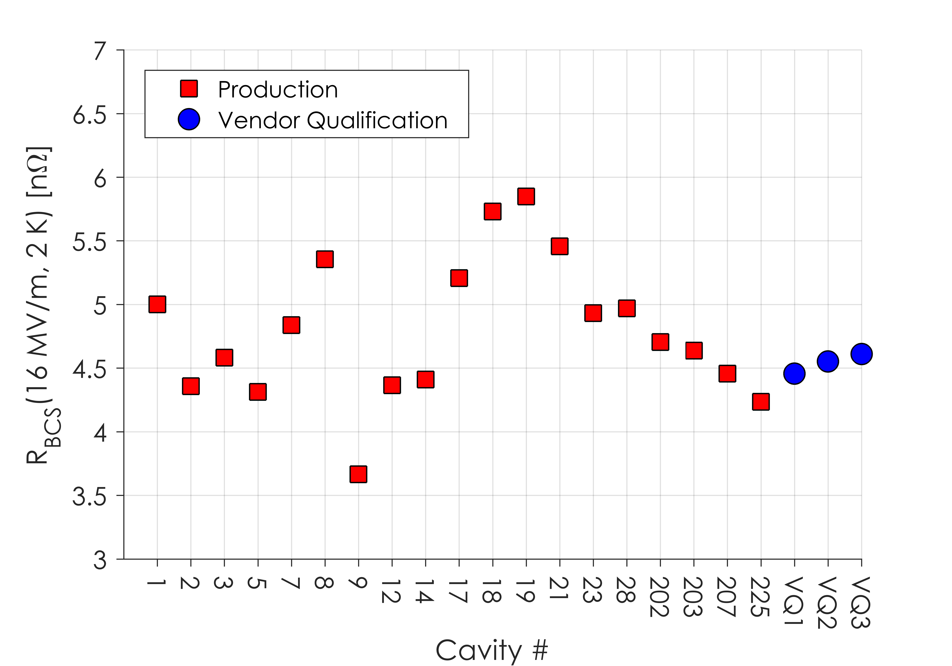
R_{BCS} in Production Cavities
R_{BCS} consistently between 4 and 6 nΩ at 16 MV/m
Mix of Material from 3 Vendors
R_{BCS} at 16 MV/m and 2.0 K is consistently 4-6 nΩ
This is consistent with “2/6” N-Doping developed in the R&D phase of LCLS-II

Slide 28
Lesson 2: The Nitrogen-Doping process can be successfully carried out at cavity vendors
R_{BCS} consistently between 4 and 6 nΩ at 16 MV/m
Mix of Material from 3 Vendors
R_{BCS} at 16 MV/m and 2.0 K is consistently 4-6 nΩ
This is consistent with “2/6” N-Doping developed in the R&D phase of LCLS-II

Slide 29
Outline
Overview of LCLS-II Cavity Requirements
Initial LCLS-II Results
Lesson Learned: Flux Expulsion
Lesson Learned: Nitrogen-Doping, R_{BCS}
Vendor B Production Results
Lesson Learned: Vendor Oversight
Conclusions and Outlook

Slide 30
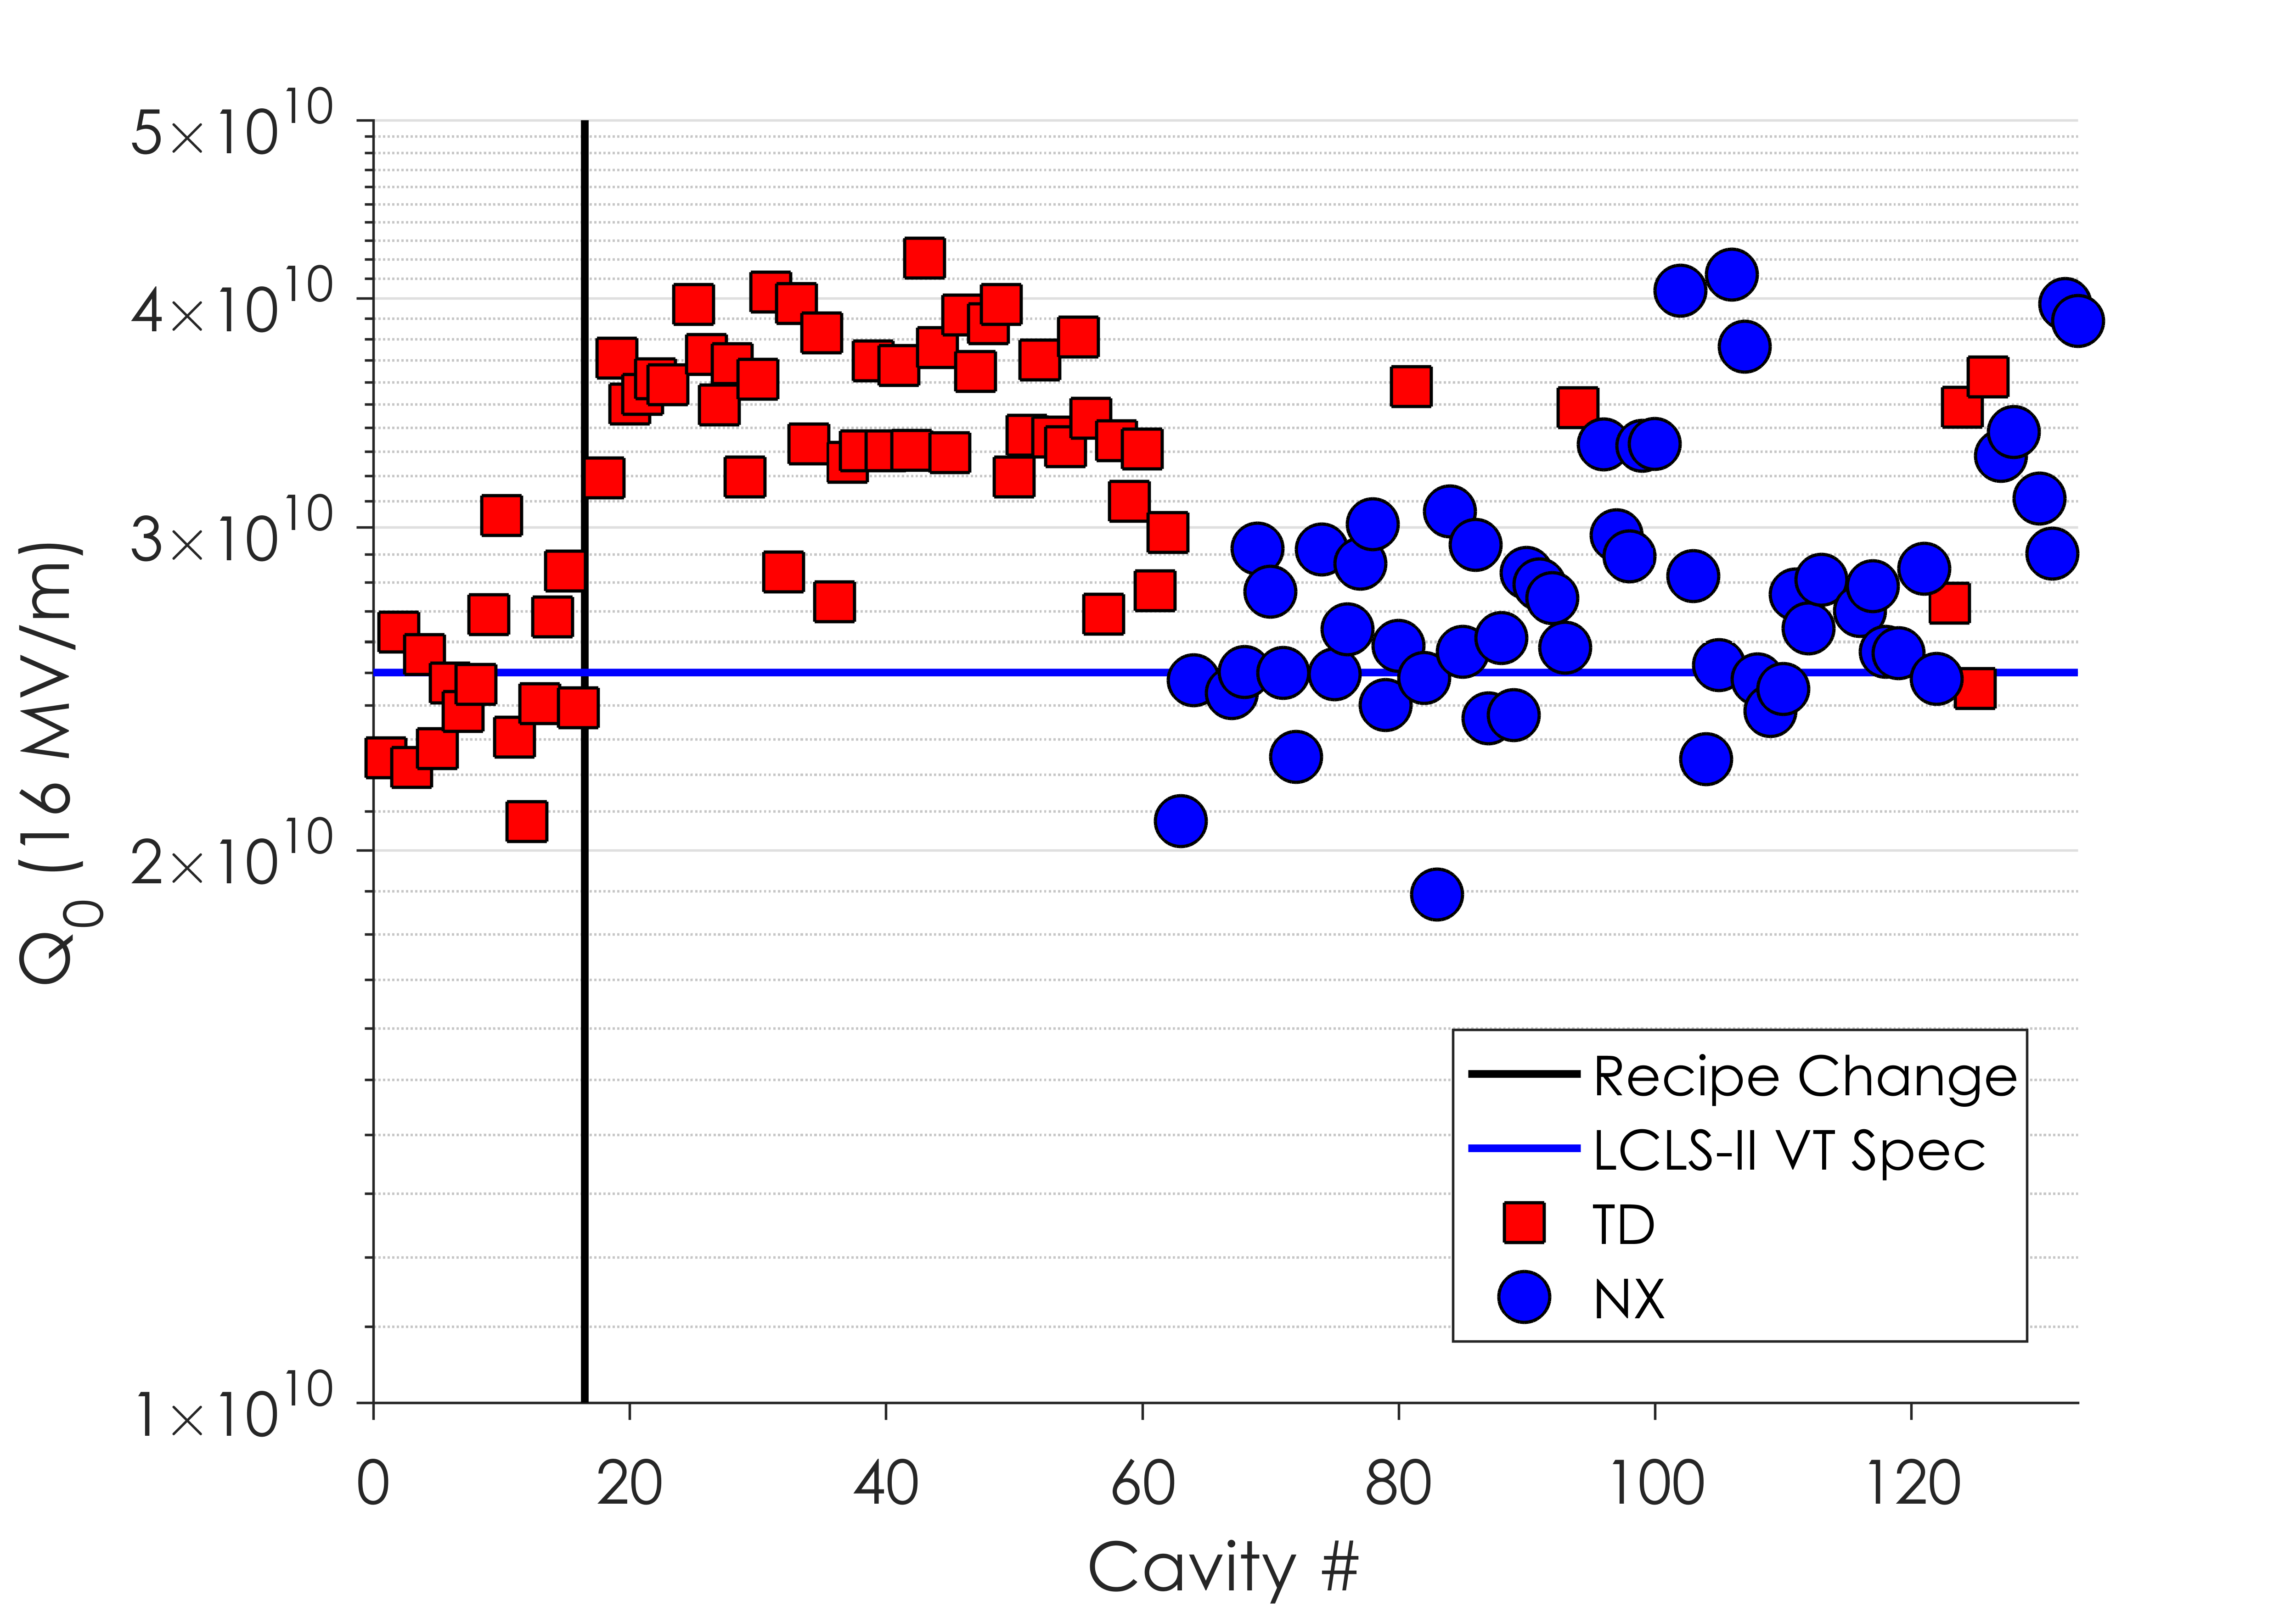
Vendor B: Q₀ Results
Vendor B has completed fabrication of original order of 133 cavities
128 cavities have been tested so far at JLab and Fermilab

Slide 31
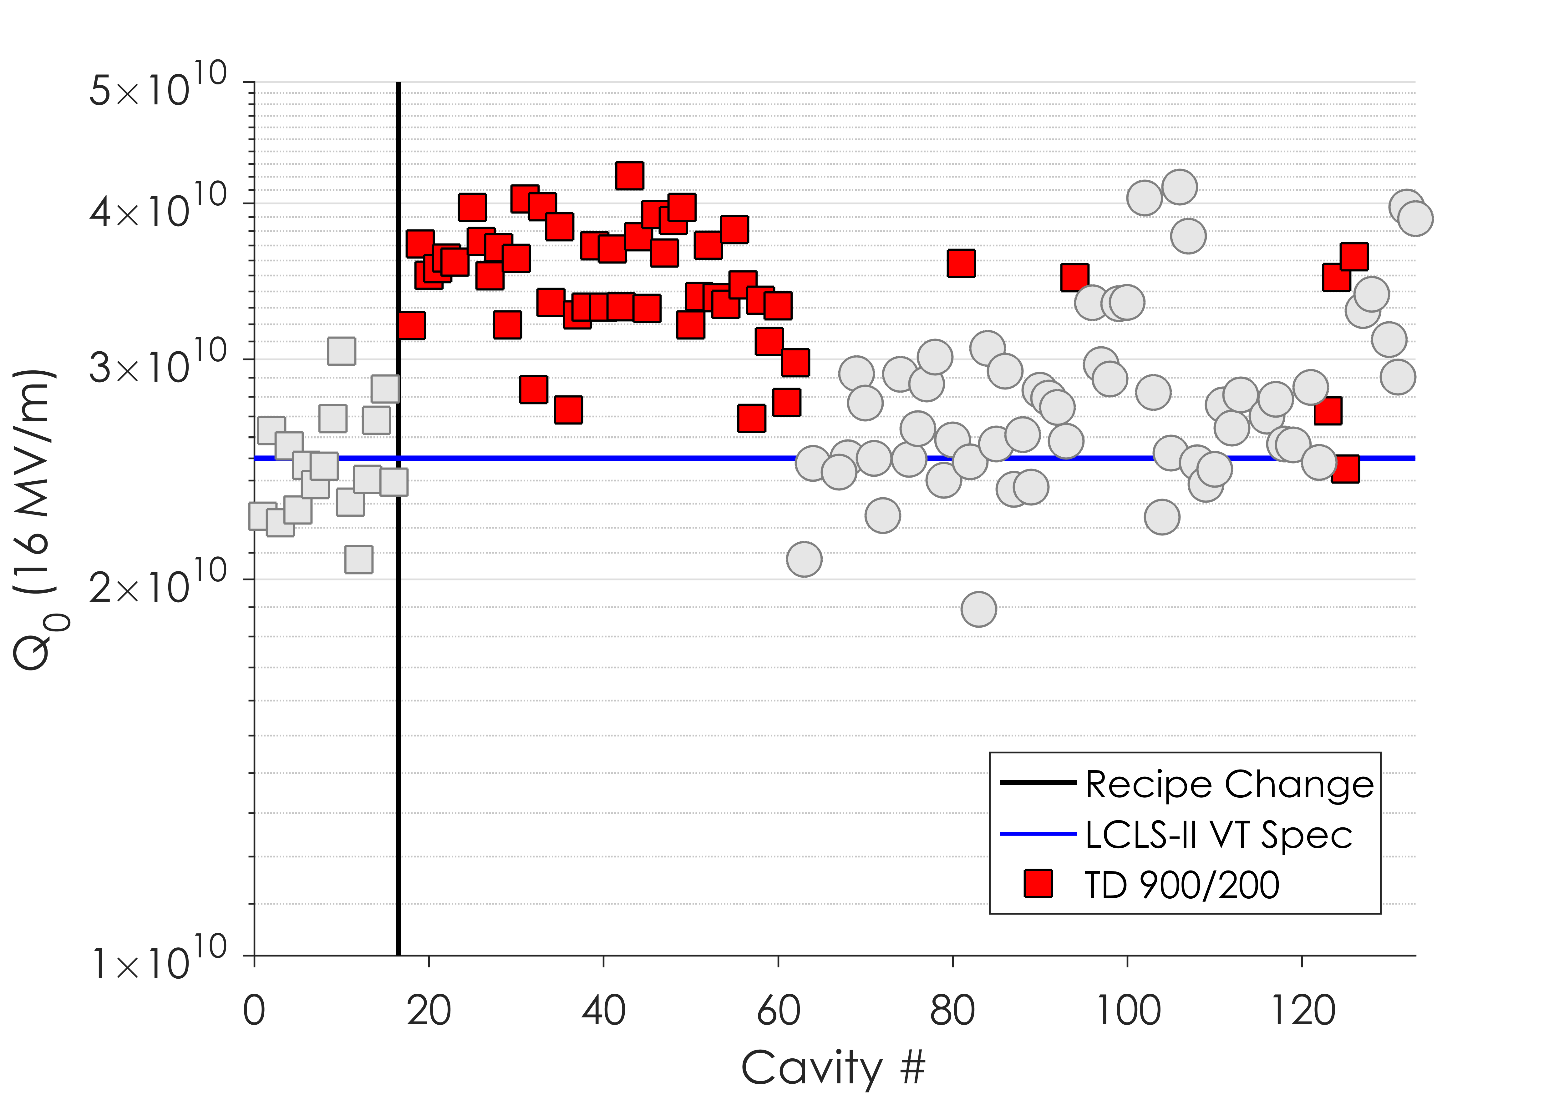
Vendor B: Q₀ Results
Vendor B has completed fabrication of original order of 133 cavities
128 cavities have been tested so far at JLab and Fermilab
TD Cavities 900/200 preparation consistently exceed LCLS-II spec

Slide 32
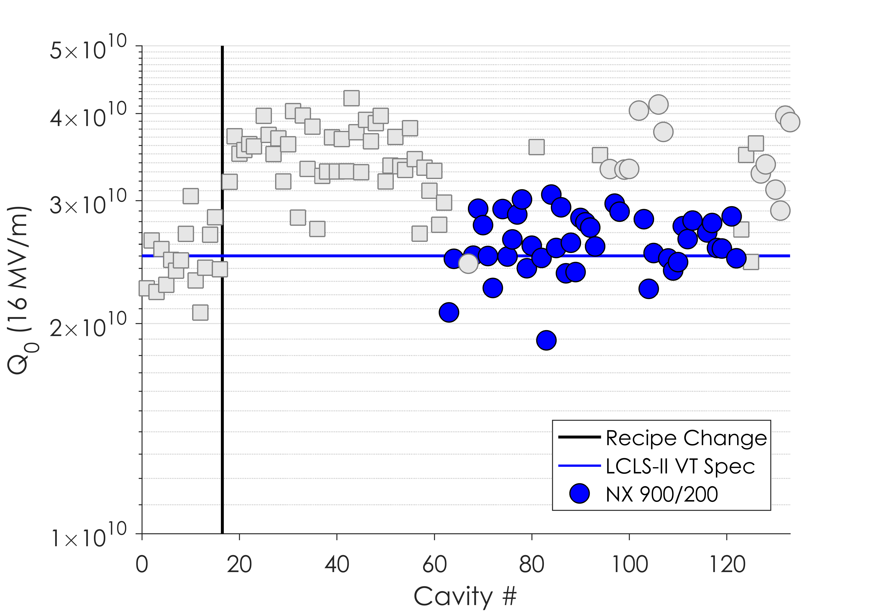
Vendor B: Q₀ Results
Vendor B has completed fabrication of original order of 133 cavities
128 cavities have been tested so far at JLab and Fermilab
TD Cavities 900/200 preparation consistently exceed LCLS-II spec
NX Cavities at 900ºC have middling results

Slide 33
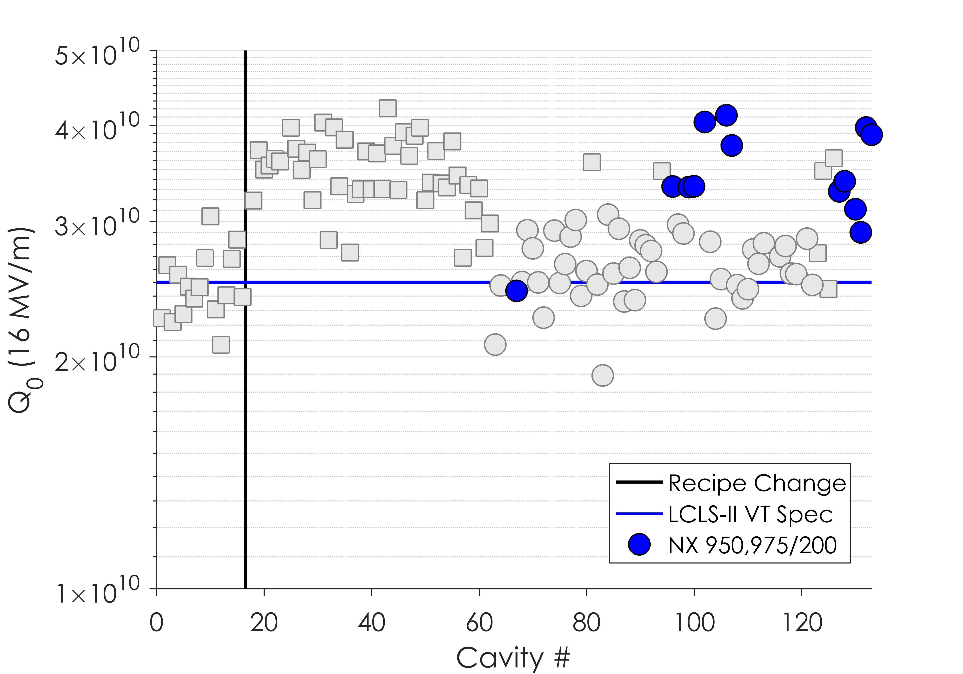
Vendor B: Q₀ Results
Vendor B has completed fabrication of original order of 133 cavities
128 cavities have been tested so far at JLab and Fermilab
TD Cavities 900/200 preparation consistently exceed LCLS-II spec
NX Cavities at 900ºC have middling results
950 and 975ºC have further improved upon the NX cavities’ performance

Slide 34
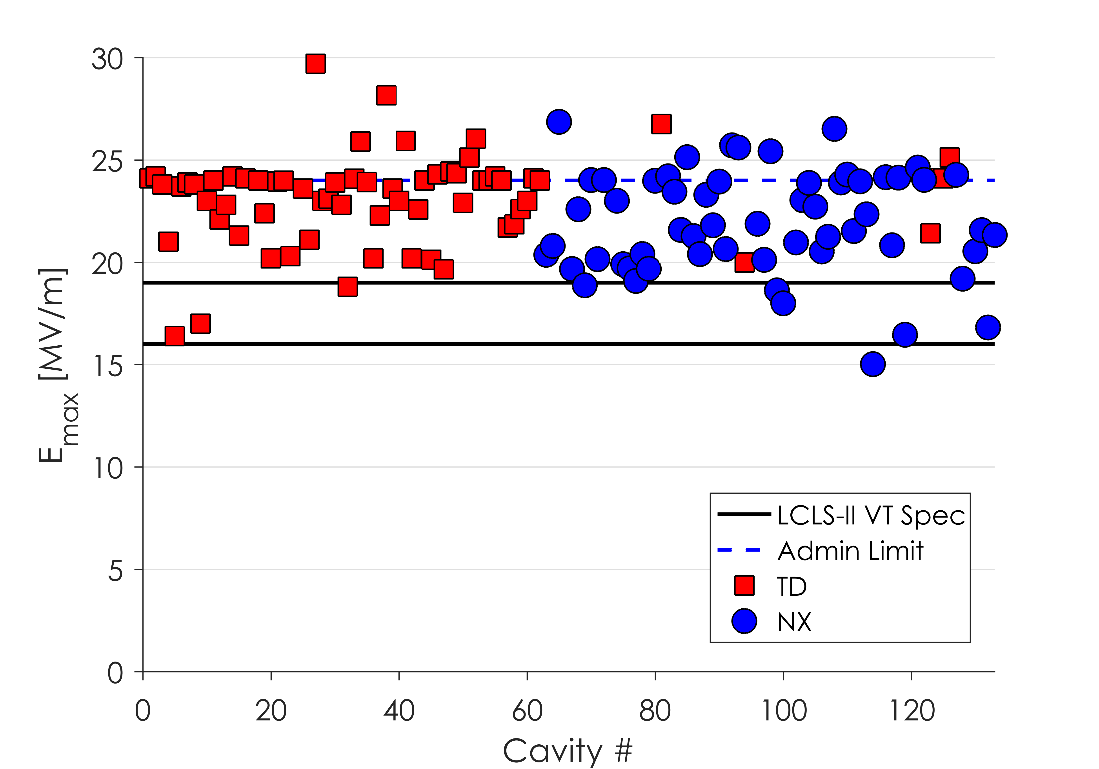
Vendor B Results
JLab employs an administrative limit at 24 MV/m during VT
Gradient reach has consistently exceeded specification throughout production

Slide 35
Outline
Overview of LCLS-II Cavity Requirements
Initial LCLS-II Results
Lesson Learned: Flux Expulsion
Lesson Learned: Nitrogen-Doping, R_{BCS}
Vendor B Production Results
Lesson Learned: Vendor Oversight
Conclusions and Outlook

Slide 36
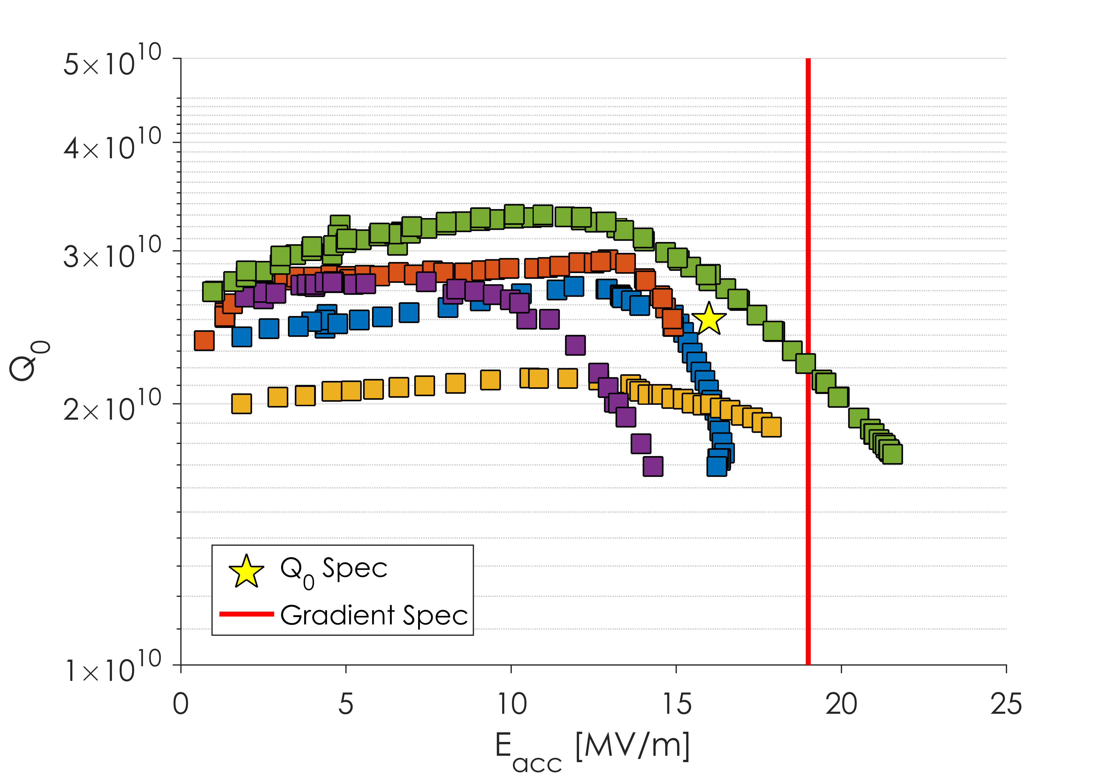
Vendor A Results
Q Slope Onset 12-14 MV/m
Vendor A cavities were dominated by a strong Q slope with onset 12-16 MV/m
This Q slope led to early quench and low Q at 16 MV/m
Subset of cavities, behavior observed in most

Slide 37
Vendor A – Surface Roughness
This Issue was Fixed
Data from Y. Trenikhina
EP at Vendor A was producing a very rough surface
Roughness was as high as 15 μm
It was found that EP temperature was leading to the EP no longer being in the “polishing regime” but in the “etching regime”

Slide 38
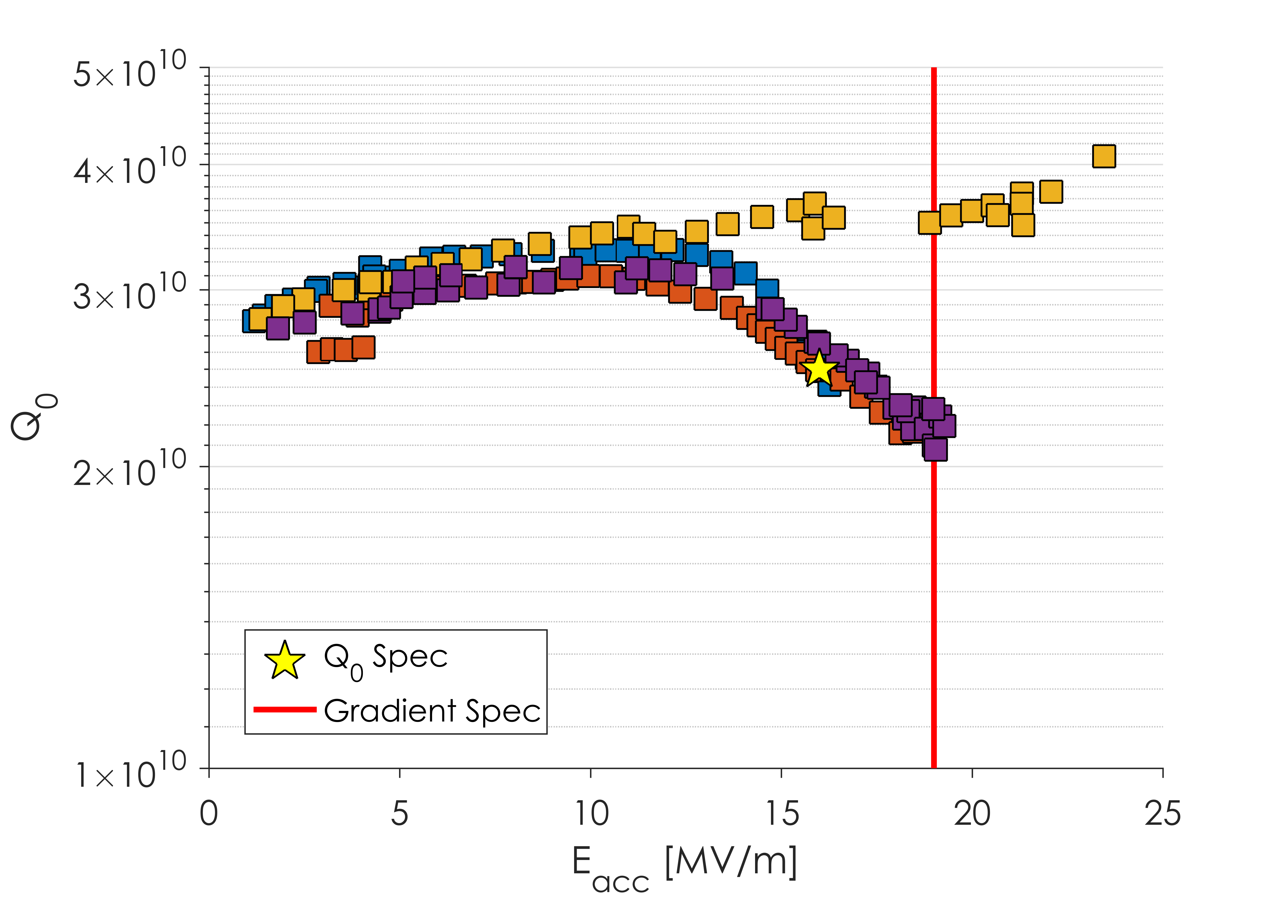
Vendor A – Surface Roughness
Q Slope Still Present after EP Procedure Change
3 of 4 cavities with “New EP” still had strong Q slope
Bad EP was not the cause of the performance issues

Slide 39
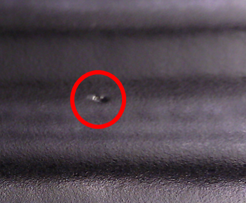
Vendor A – Grinding Technique
Visual inspection of the interior of Vendor A cavities after fabrication showed the presence of many defects
Some pits had visible normal conducting media embedded
Theorized that aggressive grinding on the dumbbell surface led to the “burying” of media
This normal conducting media would then be revealed after bulk EP
All procedures were reworked with LCLS-II staff to improve the fabrication procedures

Slide 40
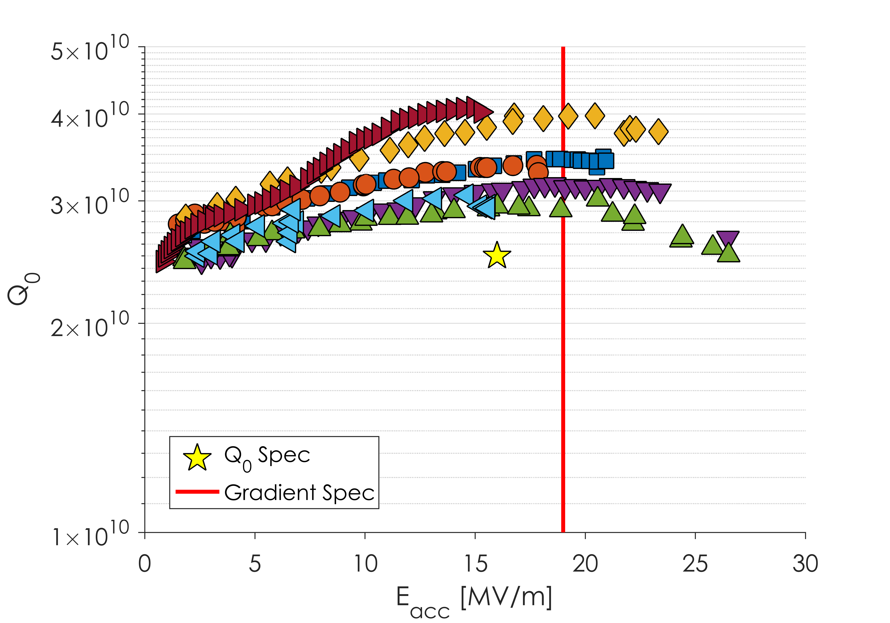
Vendor A – Restart
13 cavities with new grinding techniques have been tested
No evidence of Q slope that was seen before
4 of the 13 still had quench fields below 19 MV/m
After these 13 cavities, a new weld stack-up procedure was implemented

Slide 41
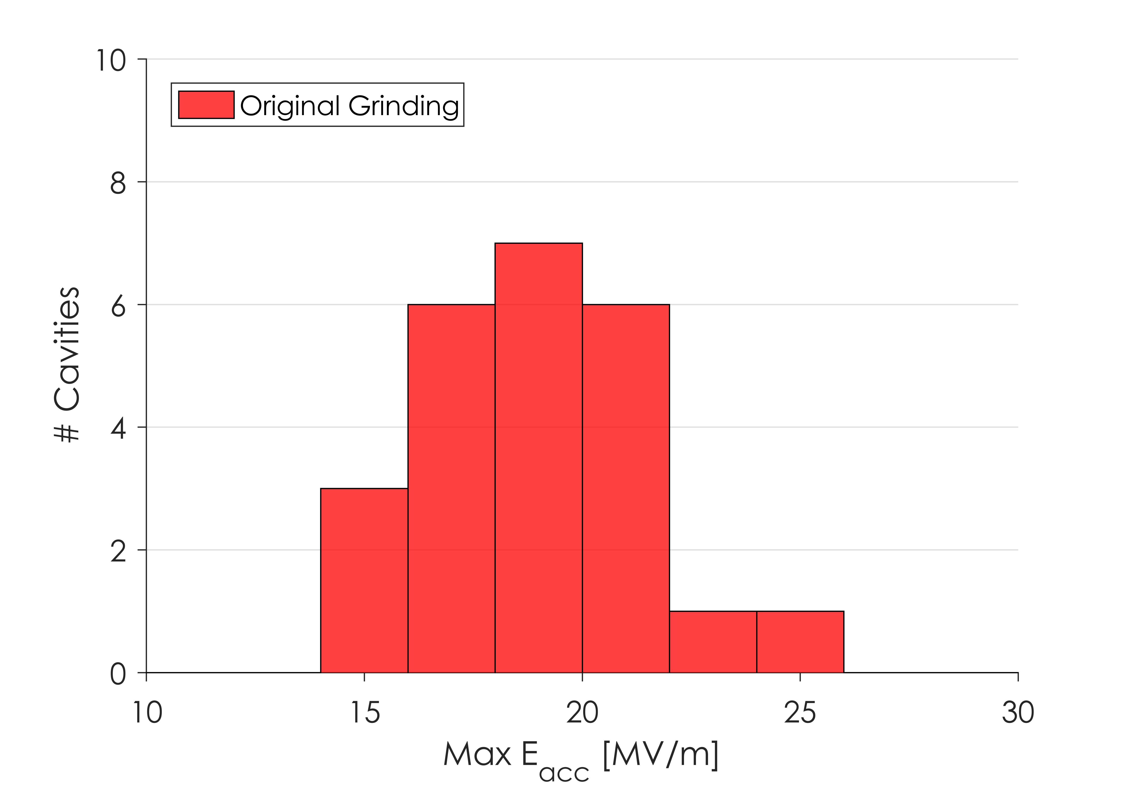
Vendor A - Restart
Cavities prepared with original grinding had poor gradient reach

Slide 42
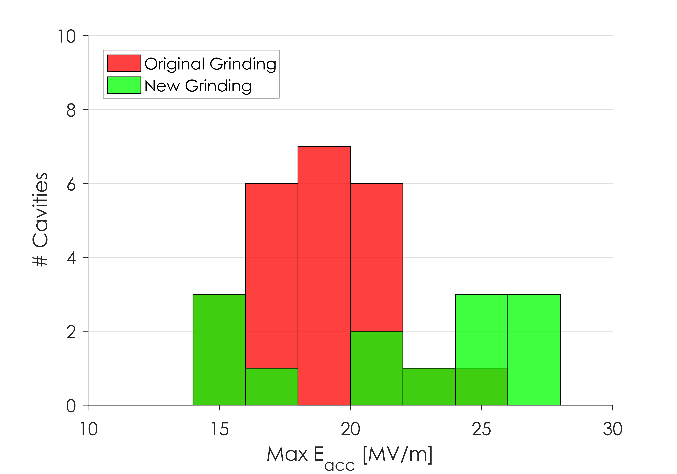
Vendor A - Restart
Cavities prepared with original grinding had poor gradient reach
Cavities with new grinding had better gradient reach but cavities were still limited

Slide 43
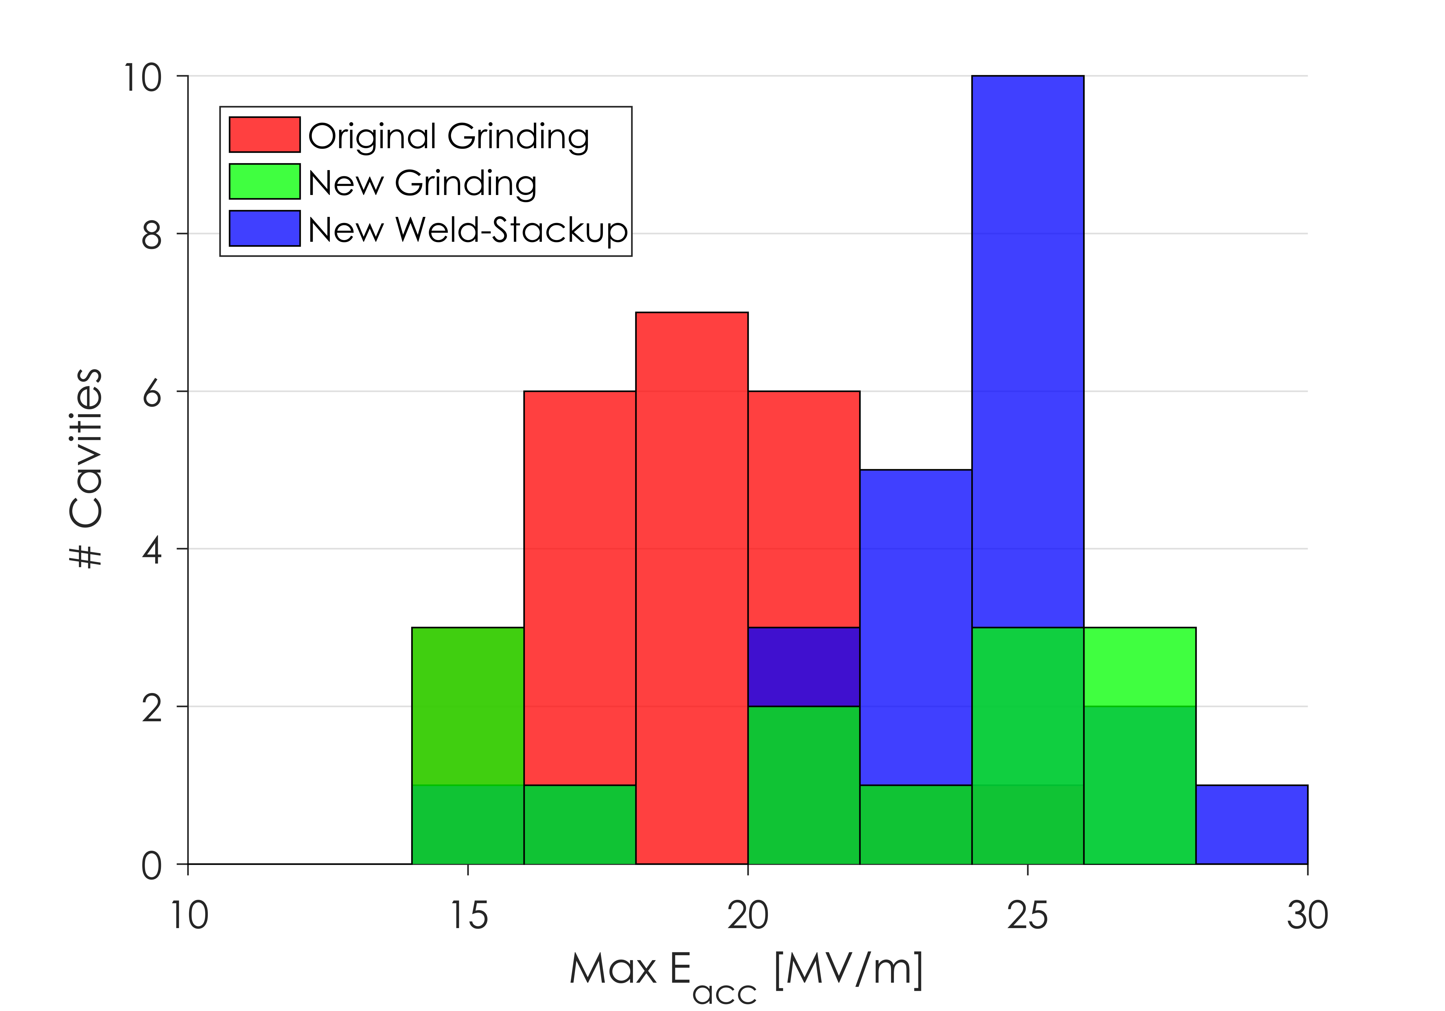
Vendor A - Restart
Cavities prepared with original grinding had poor gradient reach
Cavities with new grinding had better gradient reach but cavities were still limited
Almost all cavities with new weld stack-up meet gradient spec

Slide 44
Cavities prepared with original grinding had poor gradient reach
Cavities with new grinding had better gradient reach but cavities were still limited
Almost all cavities with new weld stack-up meet gradient spec
Lesson 3: Oversight at the cavity vendors is crucial to maintaining performance

Slide 45
Outline
Overview of LCLS-II Cavity Requirements
Initial LCLS-II Results
Lesson Learned: Flux Expulsion
Lesson Learned: Nitrogen-Doping, R_{BCS}
Vendor B Production Results
Lesson Learned: Vendor Oversight
Conclusions and Outlook

Slide 46
Conclusions and Outlook
LESSON 1: Efficient flux expulsion is necessary to maintain High Q₀ in N-Doped Cavities
A recipe change mid-production was necessary to improve flux expulsion
Cavities now consistently reach >3x10¹⁰
LESSON 2: The Nitrogen-Doping process can be successfully carried out at cavity vendors
R_{BCS} in production cavities is consistent with those from the R&D phase
LESSON 3: Oversight at the cavity vendors is crucial to maintaining performance
One of the cavity vendors had many issues in regards to cavity grinding, improper EP, and poor weld stack-up procedures which led to limited gradient reach in cavities
New procedures have brought Vendor A cavity performance in line with that of Vendor B

Slide 47
Questions?

